Slide 1
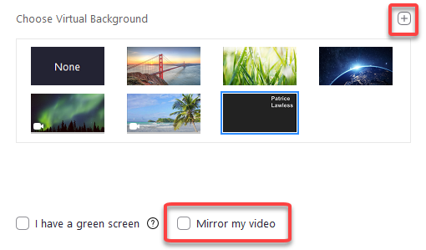
Virtual Background Instructions
Enter your name on the next slide and keep that slide selected
On PowerPoint for Windows:
Click on the File menu and select Export from the menu on the left
Click the Change File Type button
Select JPEG File Interchange Format
Click Save As, saving the file remember the location
On PowerPoint for Mac:
Select Export from the File Menu
For File Format, select JPEG; Set Width to 1920 and Height to 1080 (Height may adjust automatically)
Remember the location and click Export
On PowerPoint on the Web:
Click on the File menu and select Download As from the menu on the left
Click the Change File Type button
Select Download as Images
Click Download As, and remember the location
Extract the images from the zip file you downloaded
Open the Zoom desktop client, and Sign in
Click the profile icon in the top right corner (shows your initials or picture) > Settings
On the Virtual Backgrounds tab, click the + icon (see photo at right) > Add Image
Select your saved image file from your computer
Make sure that "Mirror my video" is not selected

Slide 2
First Name
Last Name

